Slide 1
Gradient Noise Langevin Schemes
Jikai
Kostas
Katherine
Mohamed

Slide 2
Problem statement
Learning from big data!

Slide 3
Literature review
A problem in machine learning where data teaches the algorithm what to expect for new data can be solved by two main categories of algorithms:
Optimization Methods
Sampling Methods in Bayesian Learning Framework
A third category is made up of both:
Hybrid Methods

Slide 4
Pros & cons
Optimization:
Sampling:
Ability to capture uncertainty.
Avoid overfitting
It has to go over all the data, cost-inefficient in big data

Slide 5
Aims and experiments

Slide 6
Stochastic gradient Hybrid monte Carlo

Slide 7
Aboba with minibatches and noise

Slide 8
Tensorflow investigations

Slide 9
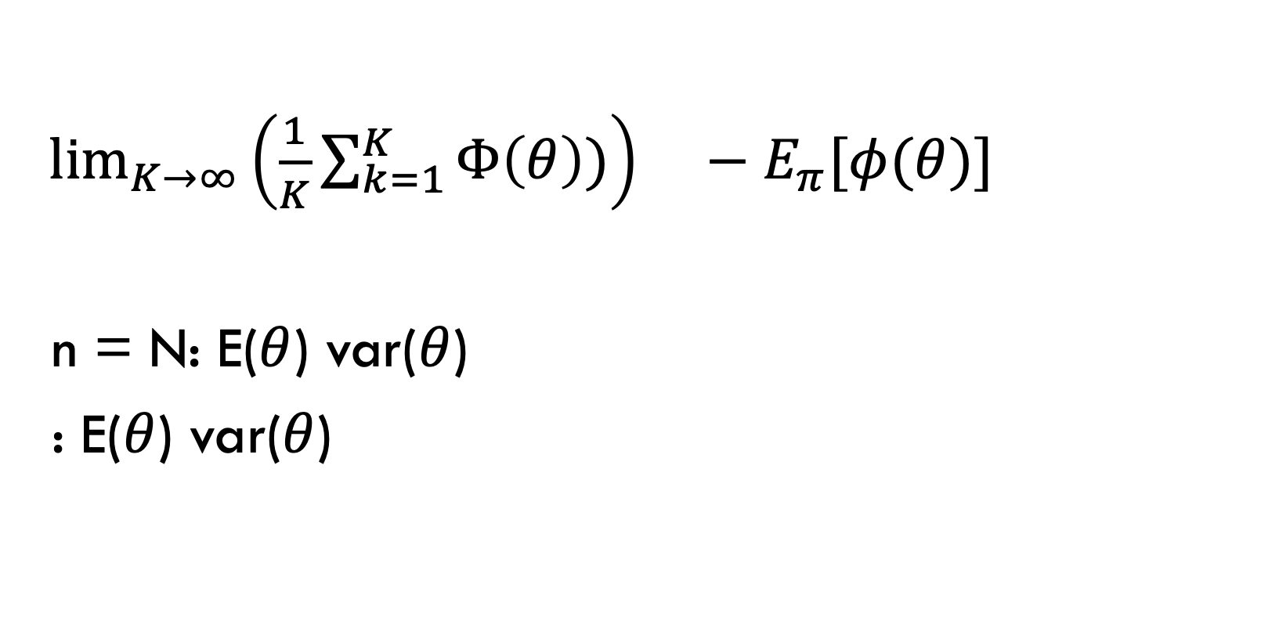
Asymptotic bias
$\lim_{K→∞}{{\left(\frac{1}{K}\sum_{k=1}^{K}{Φ\left(θ\right)})\right) }^{}}−E_{π}[φ(θ)]$
n = N: E($θ$) var($θ$)
: E($θ$) var($θ$)
SGLD
take expectation and expanxion
get and compare variance
mSGLD
remove noise in SGLD
how?
Consistancy
to convergency
n=N
E($θ$)
E(𝜃)
var($θ$)
var(𝜃)
n < N
E($θ$)
E(𝜃)
var($θ$)
var(𝜃)
Euler-marayma
SGLD
mSGLD

Slide 10
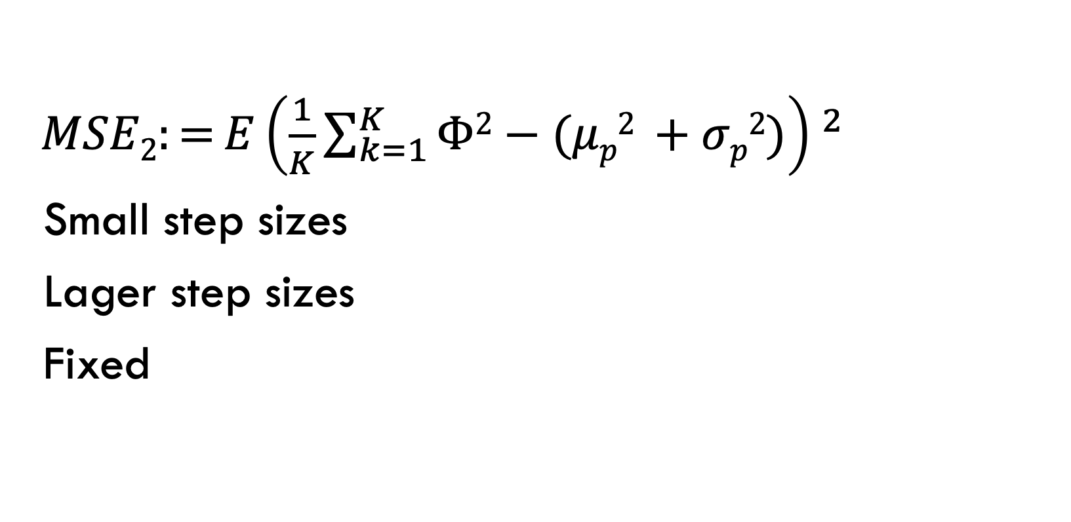
Finite time analysis
$MSE2:={E{\left(\frac{1}{K}\sum_{k=1}^{K}{Φ2}−(μp2 +σp2)\right) }^{2}}$
Small step sizes
Lager step sizes
Fixed

Slide 11
From consistency to convergency
Does h matter?
How the noise variance removed?
Ergodicity of the numerical approximation

Slide 12
M-sgld: remove noise
Does h matter?
How the noise variance removed?
Ergodicity of the numerical approximation

